Slide 1
The role of the Red cross And the rescue of the Jews.
By Jacob Strange
English
2nd period

Slide 2
o
The Start
On October 1, 1943, Adolf Hitler ordered that Danish Jews would be arrested and deported, But the Danish resistance movement and some Danish citizens managed to evacuate 7,220 of the of the 7,800 Danish Jews

Slide 3
According to the Swedish red cross, as many as 15,345 prisoners were saved from Nazi prison camp.

Slide 4
o
On June 23, 1944, a Danish delegation joined represenitive of the international red cross to visit the Theresienstadt ghetto. The prisoner that were not deported, and were released to the Red Cross on April 15, 1945

Slide 5
0
On May 4, 1945 , the final transport delivered rescued polish prisoners to Sweden.

Slide 6
A
On April 8, 1945, an air attack was launched against the White Buses at Freidrichsruh, a Danish camp, four Danish drivers and on nurse were only slightly injured

Slide 7
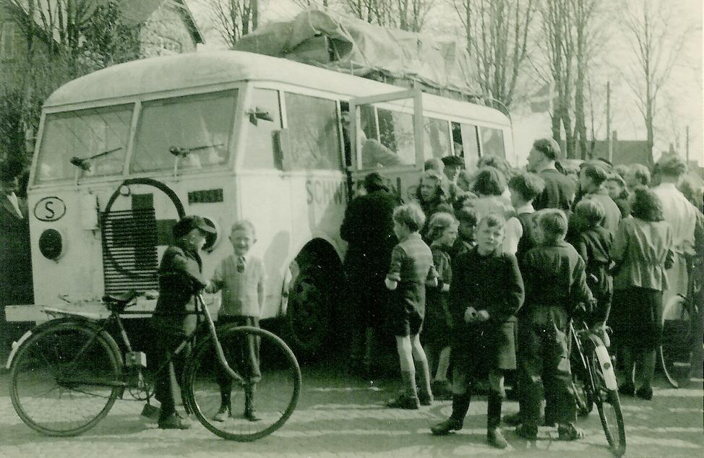
o
The White Buses
White Buses was the operation undertaken by the Sweden Red Cross and the Danish government to rescue prison camp inmates

Slide 8
o
The White Buses force include. 308 individuals, 36 ambulances, 7 motor cycles, 9 trucks, and all the necessary food, fuel, and supplies.

Slide 9
o
The white buses were used to transport prisoners from Neuengamme to other, less crowded, prison camps. Eventually, they were permitted, to transport people to Sweden, a neutral country.

Slide 10
Sources
.wikipedia.org/wiki/Rescue_of_the_Danish_Jews
auschwitz.dk/denmark.htm
www.jcpa.org/.../phas-vilhjalmsson-f0...

